Slide 1
Maximizing Speedup through Self-Tuning of Processor Allocation
Thu D. Nguyen, Raj Vaswani, and John Zahorjan
University of Washington
Presenter : Minsu Kim
17 Dec 2015

Slide 2
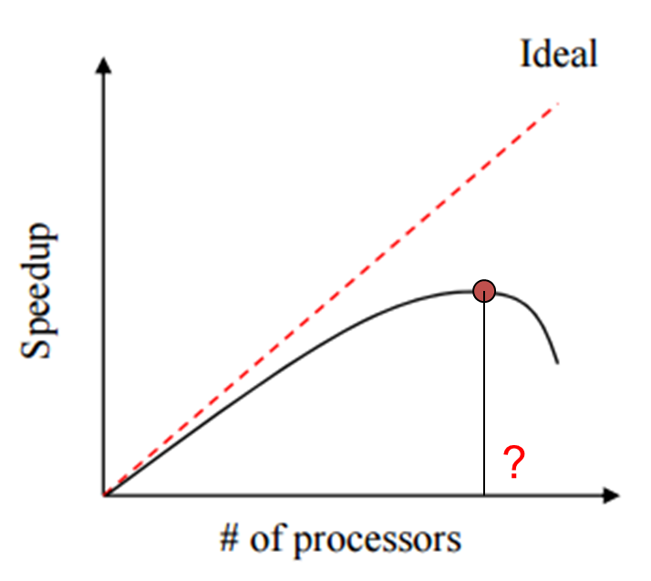
Introduction
Ideal vs Reality
Parallelization overhead
System overhead
Idleness
Communication
Dynamically
Maximize Speedup (Self-tuning!)
Static allocation may not be optimal for entire job

Slide 3
Overview
Introduction
Experimental Environments
Self-Tuning Algorithms
Basic
Change-driven
Time-driven
Multi-Phase Self-Tuning Algorithms
Independent (IMPST)
Inter-dependent (DMPST)
Conclusion

Slide 4
Experimental Environments
KSR-2 COMA shared memory multiprocessor
OS: OSF/1 (UNIX variant)
H/W monitoring unit available on each node of the KSR-2
Performing runtime measurements
Event monitor : cache misses, processor stall time, etc.
Ten parallel applications
Five Hand-coded parallel applications
Five Complier-parallelized sequential programs
Only consider iterative parallel applications

Slide 5
Runtime Measurement
Chosen runtime metric : Efficiency
Three critical HW counters (system overhead, processor stall time)
Elapsed wall-clock time
Elapsed user-mode execution time
Accumulated processor stall time
Reading these three register at the beginning and end of each iter.
Measuring idleness
Instrument all thread synchronization code to track elapsed idle time
Assume all application synchronization are invoked by calls to certain libraries.

Slide 6
Runtime Measurement
Parallelization overhead
System overhead
Idleness
Processor Stall
Efficiency = 1 - Loss
Speedup = (# of processors) x efficiency
Typically Small

Slide 7
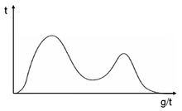
Self-Tuning Algorithms
MGB
Searches for the maximum
Iteration 1 : Search domain [1, P] => (reduced) [S(P), P]
Keep this iterative while narrowing the interval
Extension to non-unimodal S functions
Heuristic : a Greedy Algorithm
Simply continue the search in the larg- est subinterval where the largest S has found so far.
May not correct yet quite practical.
S
Step 1
S(P)
P

Slide 8
Advanced Self-Tuning Algorithms
Change-driven self-tuning Algorithm
Continuously monitors job efficiency and re-initiates the search procedure whenever it notices a significant change in efficiency
Time-driven self-tuning Algorithm
Includes change-driven self-tuning
Will also rerun the search procedure periodically regardless of change in job efficiency
Considering the possibility that job efficiency changes in the middle of a change-driven self-tuning search

Slide 9
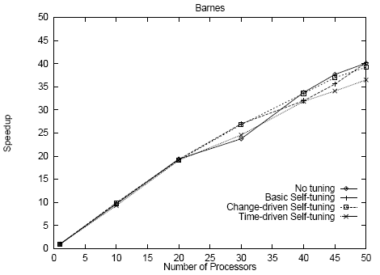
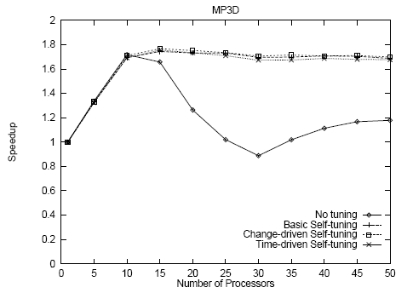
Performance
Self-tuning imposes very little overhead
Basic self-tuning can significantly improve performance over no-tuning

Slide 10
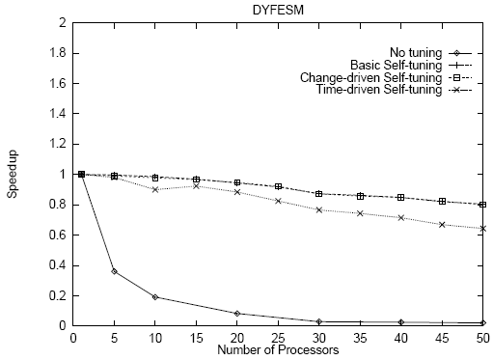
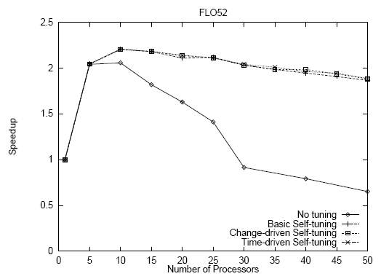
Performance
Time-driven self-tuning is not useful for the programs here
The performance benefit of self-tuning can be limited by the cost of probes

Slide 11
Multi-phase Self-tuning
One Iteration = Multiple Parallel Phases
Phase : a specific piece of code
Speedup of each phase may be maximized in different # of processors!
Extension of the problem
In an iteration there are N phases
Find a processor allocation vector (p1, p2, …, pN) which maximizes S
Actually, basic self-tuning algorithm = Find (p, p, …, p)

Slide 12
Multi-phase Self-tuning
Independent multi-phase self-tuning (IMPST)
Merely apply basic self-tuning to each phase independently
Just a naïve, simple extension
Problem : Performance of each phase ALSO depends on the allocations for other phases.
Inter-dependent multi-phase self-tuning (DMPST)
Randomized search technique
Choosing an initial candidate allocation vector
Selecting a new candidate vector (random multiplied)
Evaluating and accepting new candidate vectors until steady state
Terminating the search

Slide 13
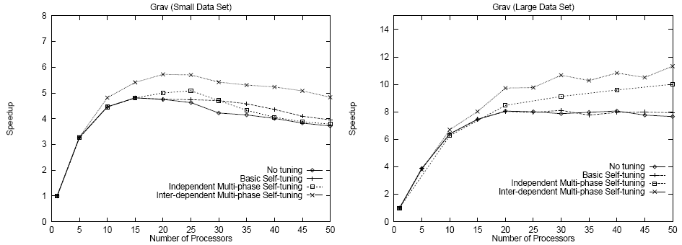
Performance
Multi-phase techniques are able to achieve performance not realizable by any fixed allocation
Inter-dependent self-tuning yields better performance than any other.

Slide 14
Conclusion
Maximizing application speedup through runtime, self-selection of an appropriate number of processors on which to run
Based on ability to measure program inefficiencies (HW support)
Peak speedups are data or time dependent
Simple search procedures can automatically select appropriate numbers of processors
Relieves the user from the burden of determining the precise number of processors to use for each input data set
Potential to outperform any static allocation

